Slide 1
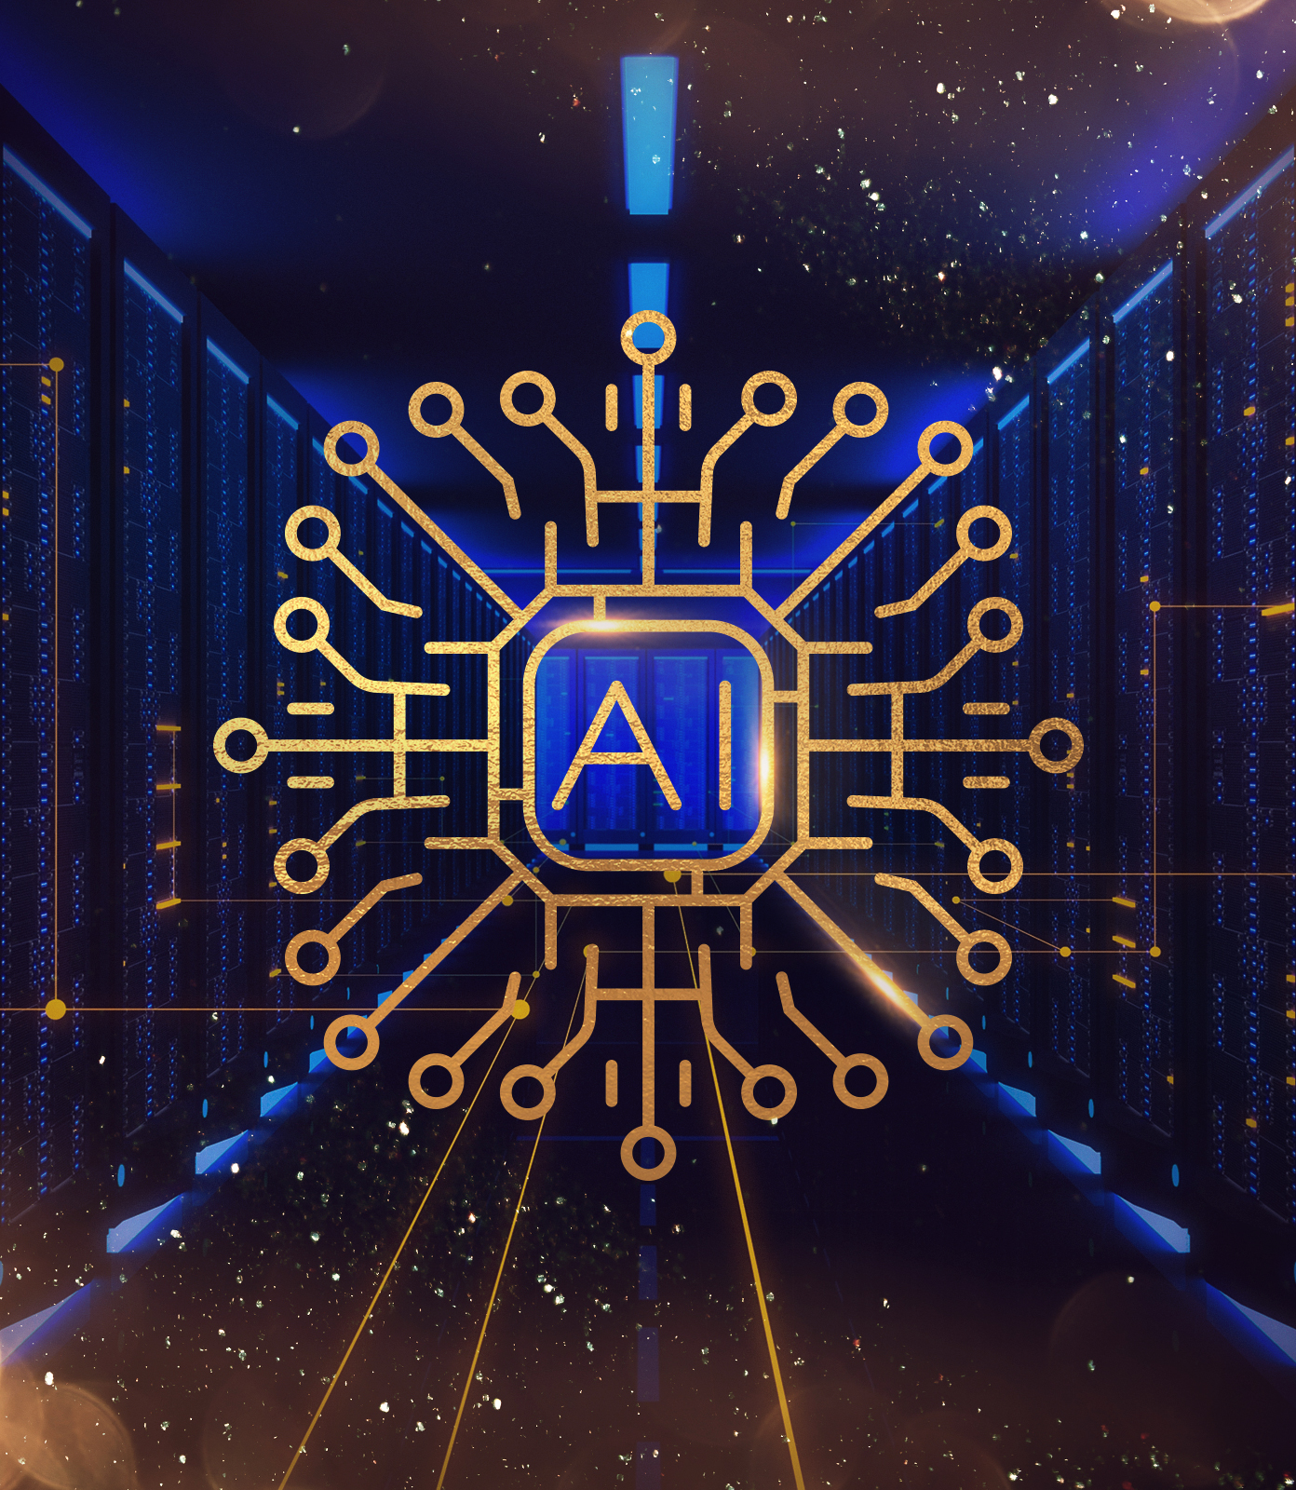
Introduction to AI
Iftekhar Mahmud Towhid,
CSTE, NSTU

Slide 2
Course outlines
This course will be divided into two parts:
  Classical Artificial Intelligence (1/3 of this course)
  Machine Learning (2/3 of this course)

Slide 3
Topics we will cover
Introduction to AI (This class)
Search (3 lectures)
  State Space Search
Game theory (2 lectures)
  Minimax algorithm
Genetic algorithm (GA)
Probabilistic models (3 Lectures)
  Bayesian Network
  Decision Tree
  Ant colony optimization (ACO)

Slide 4
Topics we will cover (cont.)
Machine Learning
  Supervised, Unsupervised, Reinforcement Learning
Introduction to Neural Networks
  Neural networks
  Backpropagation algorithm
  Activation functions
  Multi-layer Perceptron (MLP) network
Dataset management
  Creation and curation
Convolutional Neural Network (CNN)

Slide 5
Topics we will cover (cont.)
Recurrent Neural Network (RNN)
  Long Short Term Memory (LSTM)
  Gated Recurrent Unit (GRU)
Generative AI
  Autoencoders
  Variational Autoencoder (VA)
  Generative Adversarial Network (GAN)
Transformer Architecture
  Application in Large Language Models (LLMs)
Diffusion model

Slide 6
What is Artificial Intelligence?
Intelligence should be described in the context of biology
  Intelligence connects perception to action to help organisms survive.
Intelligence does not imply perfect understanding, every intelligent being has limited perception, memory and computation.
AI seeks to understand the computations required for intelligent behavior and to produce computer systems that exhibit intelligence.
Aspects of intelligence studied by AI include perception, motor control, communication using human languages, reasoning, planning, learning and memory.

Slide 7
What is Artificial Intelligence?
Formal definition: Artificial Intelligence (AI) is a branch of computer science and engineering that deals with intelligent behavior, learning, and adaptation in machines.
“Artificial Intelligence (AI) is the study of how to make computers do things which, at the moment, people do better.”
-- Elaine Rich, 1991
“AI is the art of creating machines that perform functions that require intelligence when performed by people”
-- Kurzweil, 1990

Slide 8
What is Artificial Intelligence?
“AI is the branch of computer science that is concerned with the automation of intelligent behavior.”
-- Luger and Stublefield, 1993
"AI is a field of study that seeks to explain and emulate intelligent behavior in terms of computational processes"
--Schalkoff, 1990

Slide 9
What is Artificial Intelligence?
My definition:
AI deals with a class of algorithms which generate solution which (appears to be) non-deterministic, thus looks intelligent.

Slide 10
Aims of AI
AI trying to exhibit behavior like –
  Thinking humanly
  Acting humanly
  Thinking rationally
  Acting rationally

Slide 11
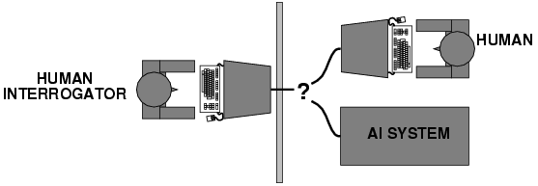
Acting humanly: The Turing Test
The Turing Test, proposed by Alan Turing (1950), was designed to provide a satisfactory operational definition of intelligence. Turing defined intelligent behavior as the ability to achieve human-level performance in all cognitive tasks, sufficient to fool an interrogator. Roughly speaking, the test he proposed is that the computer should be interrogated by a human via a teletype, and passes the test if the interrogator cannot tell if there is a computer or a human at the other end.

Slide 12
Problems we try to solve by AI
Finding solution to problems:
  Path finding
  Solution to a puzzle
Reasoning
Planning
Decision making
Inference
Classification
Pattern recognition
Regression
Synthesis

Slide 13
History of AI
Antiquity to 1940s: The concept of AI began with myths and stories of artificial beings. Philosophers attempted to describe human thinking as the mechanical manipulation of symbols, which led to the invention of the programmable digital computer.
1956: The field of AI research was officially founded at a workshop at Dartmouth College. Early predictions were optimistic about the potential of AI.
1974-1980: The first AI winter occurred due to a lack of progress, leading to reduced funding and interest in AI research.
1980-1987: A resurgence of interest and funding in AI, particularly in expert systems.
1987-1993: The second AI winter happened as investors became disillusioned with the lack of practical returns.
1993-2011: Gradual progress in AI, with the development of machine learning and data-driven approaches.
2011-2020: Significant advancements due to deep learning, big data, and increased computational power.
2020-Present: The era of large language models and widespread AI applications in various industries.

Slide 14
Applications of AI
AI has found extensive applications across various sectors, transforming industries and daily life:
E-commerce: AI provides personalized shopping experiences and recommendation systems.
Healthcare: AI assists in diagnostics, treatment planning, and personalized medicine.
Finance: AI is used for fraud detection, algorithmic trading, and customer service.
Transportation: Autonomous vehicles and traffic management systems are powered by AI.
Manufacturing: AI enhances production efficiency through predictive maintenance and robotics.
Education: AI offers personalized learning experiences and automates administrative tasks.
Entertainment: AI generates music, art, and video games, and personalizes content delivery.
Customer Service: AI powers chatbots and virtual assistants for improved user interactions.

Slide 15
Machine learning
Machine learning is a branch of artificial intelligence that focuses on the development of algorithms and models that allow computers to learn and make predictions or decisions without being explicitly programmed.
Machine learning algorithms learn from data by identifying patterns and relationships. They use this knowledge to make predictions or decisions on new, unseen data.
The main types of machine learning are supervised learning, unsupervised learning, and reinforcement learning. Supervised learning uses labeled data to train models, unsupervised learning finds patterns in unlabeled data, and reinforcement learning learns through trial and error based on rewards or punishments.
Machine learning is used in various domains, including healthcare (diagnosis and treatment prediction), finance (fraud detection), marketing (customer segmentation), and autonomous vehicles (object recognition and decision-making).

